Slide 1
WAGADU Action Alliance Sharing Knowledge and Influence

Slide 2
WAGADU - First West African Empire
Wagadu was the first ever empire in West Africa that encompassed several African countries. It was created by descendant of Black Egyptians that migrated to the West
Wagadu lead to the creation of world class states such as Ghana, Songhai, Mali… that centuries before Colombo, sent explorative boats across the Atlantic to the Americas
During that golden age from 500 to 1200 AD, Africa lead the world in sciences, technology and political institutions
Timbuktu houses the world oldest university. The University of Sankore has its roots in the Sankore Mosque which was founded in 989 AD
The Mandeen Charter from 1200 AD, one of the oldest constitutions in the world advocating social peace in diversity, the inviolability of the human being, education, the integrity of the motherland, food security, the abolition of slavery, freedom of expression and trade

Slide 3
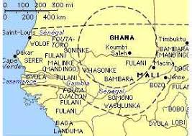
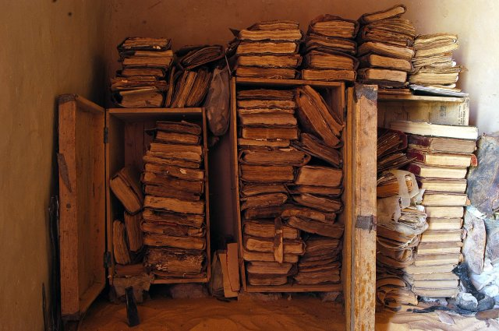
HUMAN RIGHTS IN MANKIND
1236 - The Charter of Kurukan Fuga in Mali
1789 - French Declaration for Human and Citizen Right
1948 - Universal declaration of human right December

Slide 4
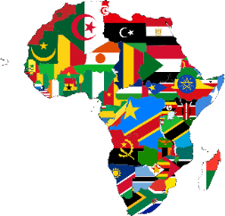
WAGADU
OBJECT
WAGADU aims to be a collaborative platform, a Think Tank where all the stakeholders of Africa's future, specialized experts, scientists, politicians, civil society, communities and diasporas intervene and combine their efforts to help reveal the great challenges of its development

Slide 5
WAGADU
VISION
Stimulate a holistic approach of human empowerment bring adapted solutions for a qualitative an permanent changes, through the combination of the millennium African relationship with human and nature as well as the diversity of knowledge from all parts of humankind.
MISSION
With an African angle, contributes to the:
Improvement of the human capital
Sustainable development & Generation of revenue
Respect to the environment
STRATEGY
Focussing on systems with high impacts, through deep analysis from multiple angles, provide a efficient receptacle for Research, Innovation, Reflection, Learning, Lobbying, Economic and Cultural actions related to Africa.

Slide 6
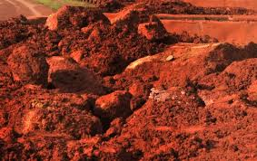
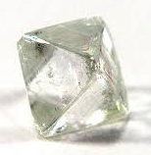
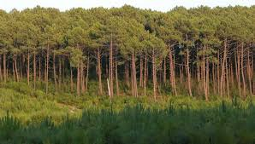
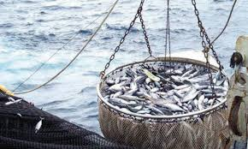
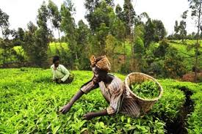
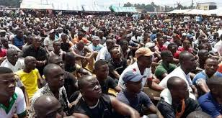
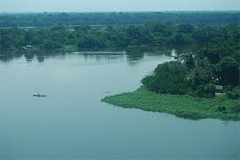
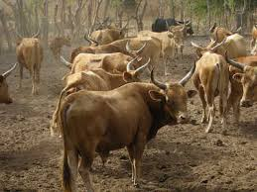
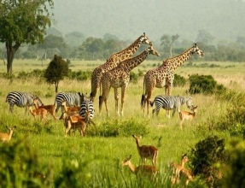
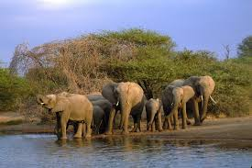
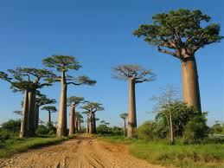
AFRICA IS RICH
WAGADU
Attic of the world in natural resources mining, oil and gas
30% of the world reserves in ores of which 40% of the reserves in gold, 60% of the cobalt and 90% of the platinum, 21% in uranium).
16.5% of the world's arable land, for 16% of the population.
The sunniest continent in the world
Population 1.6 billion people by 2030, 19% of the world's population, with 64% of the population under 25 years old.
Source Source 2

Slide 7
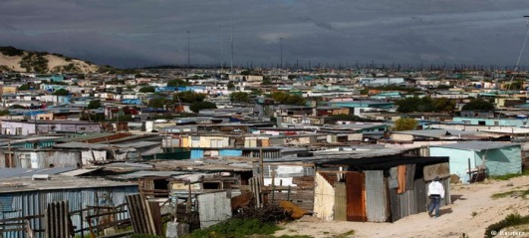
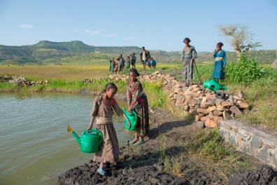
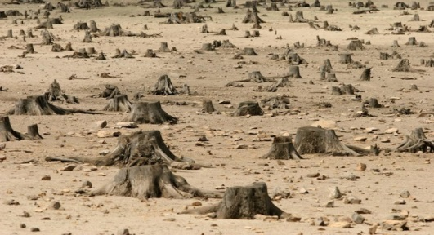
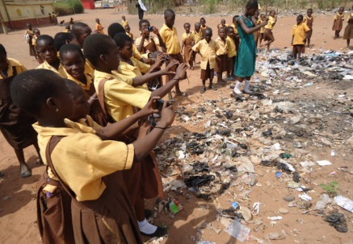
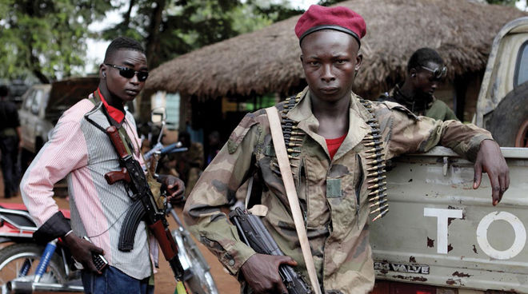
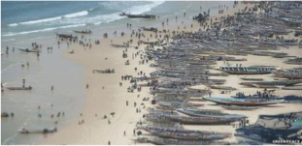
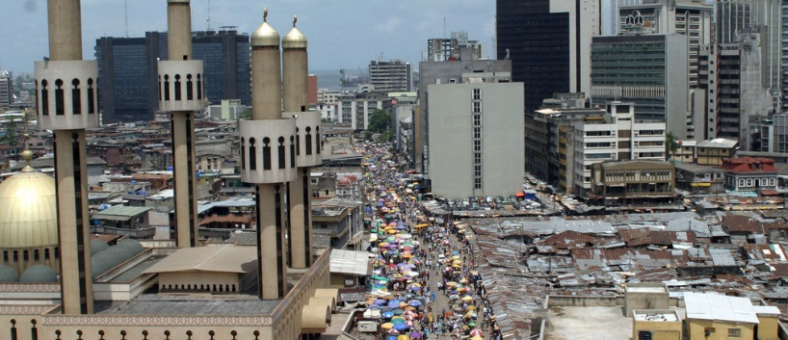
BUT A PARADOX !!
WAGADU
Africa 'the richest continent on Earth is the poorest'
Dr. Arikana Chihombori-Quao, African Union envoy to the US
Poverty
Destruction of
environment
Civil wars
Governance and
transparency issues
Immigration

Slide 8
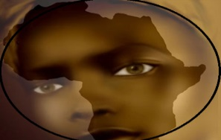
POWER ANALYSIS
WAGADU
Socio economic context:
Food insecurity
Unemployment
Environnemental issues
etc……
Implementation:
Lack of capacity
Lack of resources
Beneficiary not involved from the beginning
etc……
Non adapted solutions
Based on analysis out of African paradigm,
Research and Innovation not contextualised
Top down approach
Decision making process
etc….
Solutions:
Lack of alternatives
African voice not heard
Governance and transparency require improvement
etc……
Strategies:
Unknown
Not define with clarity; require more coherence
Resources are not exploited sustainably for the benefit of communities
etc……

Slide 9
BUT AFRICA IS ON MOVE …
WAGADU
While governance need improvement, 11% African countries have a better corruption perception index than some G7/EU member, 29% have a CPI equal or better than the largest world democracy , 56% have CPI equal or better than the largest Eastern Europe economy
In 2016, Africa as a whole was the most attractive region of the world for investment, second only to South Asia and world’s second-fastest growing economy to 2020.
Africa’s collective GDP is estimated to reach 3.8 trillion USD to 2020, fifth largest world economy (nominal GDP) The return on foreign investment is higher in Africa than in any other developing region
Sub-Saharan Africa made the most progress against HIV, cutting the rate of new infections by 30% in the past 7 years in contrast to the global average of 18%.
Out of the 10 countries with the world highest gender score index (GSI), 20% are from Africa . 31% of African countries have a GSI higher than the global average.

Slide 10
CHALLENGES TO OVERCOME …
NEW
TECHNOLOGIES
REGIONAL
INTEGRATION
GOVERNANCE
EDUCATION
HEALTH
SECURITY
FOOD
SECURITY
INDUSTRIALISATION
ENVIRONMENT
& CLIMAT
INFRASTRUCTURE
SUSTAINABLE DEVELOPMENT
EMPLOYMENT

Slide 11
THE OPPORTUNITIES
WAGADU
Africa is to reach $1.3 billion inhabitants by 2020 and the region is expected to have a larger workforce than either China or India by 2034
Consumer-facing industries; infrastructure- related industries; and agriculture are expected to be worth $2.6 trillion in annual revenue by 2020
Annually a USD 93 billion investment is required for Africa to meet its infrastructure needs – (44%) for energy, (23 %) for water and sanitation, (20%) for transport, (10 %t) for ICTs and 2.79 billion (3%) for irrigation
With 60% of the world’s total amount of uncultivated, arable land, agriculture is the most promising growth opportunity in Africa.s
The African Continental Free Trade Agreement (AfCFTA) signed 21 March 2018 between 49 African Union member states to create a single market followed by free movement and a single-currency union.

Slide 12
STAKEHOLDERS
WAGADU
Text
Financial Partners
Civil Societies
Text
States
Text
Text
Text
Communities
Research Institutes & Universities
Text
Text
WAGADU
Diaspora
Text
Regional & International Organizations
Text
Text
Corporates
Text
Text

Slide 13
ADVISORY BOARD
WAGADU
Text
Political science
Finance
Text
Text
Text
Technological innovations
Text
Sustainable development
Business
Text
Text
Security
Text
Legal & Governance
Text
Text
Education & Health
Text
Text

Slide 14
WAGADU
BRING
Support for Sustainable Development
Research and Innovation
Partnership and Collaboration
Adapted Strategies
USING
AFRICAN COMMUNITIES
IN
WAGADU
WITH
QUALITY OF LIFE
ADAPTED SOLUTION

Slide 15
TECH INNOVATIONS EXAMPLES

Slide 16
Thank YOU !!!

